Slide 1

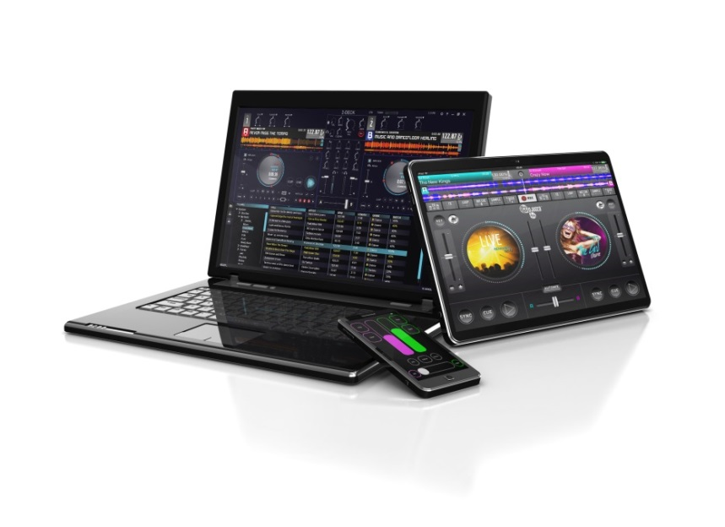

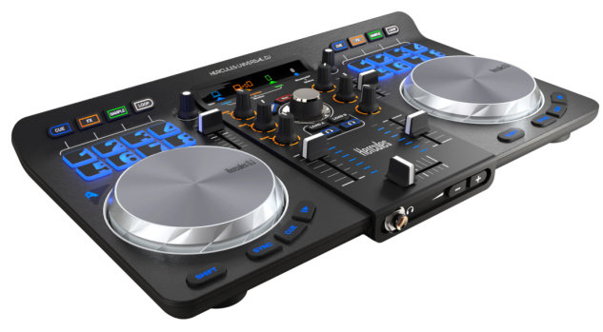










www.hercules.com
Laptop, Tablet, smartphone are not included
The DJ Party 3.0
1 - UNIQUE: The ideal ecosystem for connected DJs. Finally, control your mixes from all your devices – Android, iOS, PC and Mac!
  1 controller, 1 program, 2 applications, 3 modes... and much more!
  The external source input allows you to connect any smartphone or tablet (using the included cable) and instantly access all your playlists on Spotify, Deezer or other music streaming services. Add EQs and samples at your convenience!
2 - Unrivalled FREEDOM – experience the party from the heart of the dance floor, at any time!
  Enjoy the freedom to move and groove with your party's crowd. In addition to your computer, you can also control your mix from your smartphone or tablet using built-in Bluetooth® wireless technology and the My Remote module provided by the dedicated DJUCED™ Master app
  Keep your transitions under control! And if you are caught in the middle of a conversation or a drink - the PANIC button is there to help you out, enabling you to automatically launch the best next track!
  3 - Be as creative as a pro DJ.
    The DJUCED™ Master application's My Extender module lets you unleash your creativity.
    With just one finger, create loops and FX combos worthy of a pro DJ! A feature delivering truly professional effects that has never been so simple and fun.
4- NEVER SEEN BEFORE! Let the people at your party chime in, for a perfect party!
  Prepare your party by sharing your playlist with your guests through DJUCED™ 40°, and ask them to vote for their favorite tracks. The DJUCED™ Master application allows you to view the votes in real time. Hone your playlists to please your guests!
  During the party, ask your guests to vote for their favorite tracks and customize your playlist according to their requests – live! The highest-voted playlist is visible on your second device (tablet or smartphone), allowing you to track it in real time.
  View the tracks, artists or special messages submitted by your party's guests. Customized playlists for unforgettable parties!
5- Reinvent your parties… and beyond
  Share your ideas or needs to constantly build this evolutionary app. Much more soon!
© 2014 Guillemot Corporation S.A. All rights reserved. Hercules® is a registered trademark of Guillemot Corporation S.A. Apple and iPad are trademarks of Apple, Inc, registered in the United States of America and other countries. The Bluetooth® word mark and logos are registered trademarks owned by Bluetooth SIG, Inc. and any use of such marks by Guillemot Corporation is under license. Microsoft®, Windows® XP, Windows® Vista, Windows® 7, Windows® 8 are registered trademarks of Microsoft Corporation. All other trademarks and brand names are hereby acknowledged and are the property of their respective owners. Images and illustrations not binding. Contents, designs and specifications are subject to change without notice and may vary from one country to another.

Slide 2

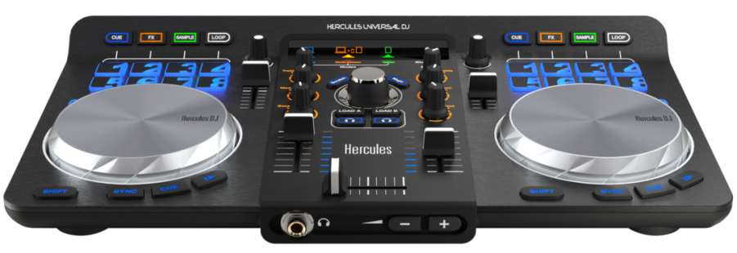

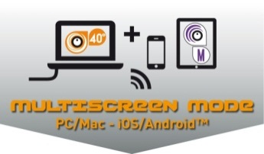
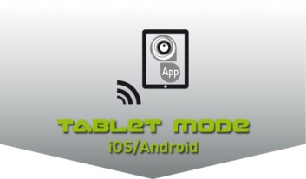

Technical specifications
DJ controller with dual mixing decks Bluetooth® wireless technology - Built-in audio (Mix + Preview outputs / External input) - Capacitive jog wheels - 16 performance pads
Comprehensive software suite: DJUCED™ 40°for Mac®/PC DJUCED™ Master for iOS / Android DJUCED™ App for iOS / Android
www.hercules.com
Physical specifications
Measurements: 40 (L) x 23 (D) x 4,5 (H) cm
Jog wheels diameter: 11 cm
Weight: 1.5 kg
Required configuration
DJUCED™ 40° PC / MAC 2 GHz or faster CPU 2 GB RAM ore more Windows Vista, 7, 8 (32 and 64 bits) MAC OSX 10.7 and higher (32 and 64 bits)
DJUCED™ Master (iOS and Android) iOS 7 and higher / Bluetooth® 4.0 iPhone 4S, iPod Touch 5, iPad mini, iPad 3 and later devices Android 4.0 and higher / Bluetooth® 3.0
DJUCED™ App (iOS and Android) iOS 7 and higher / Bluetooth® 4.0 iPad mini, iPad 3 and later devices Android 4.0 and higher / Bluetooth® 3.0
Check your device compatibility here:
1 DJ controller, 3 modes!
PC/Mac® LAPTOP MODE: Mix essentials
  Ignite the dance by mixing with your controller and your computer
  Control DJUCED™ 40°from your Mac® or PC (via a USB connection)
  Compatible with MIDI DJing software
MULTISCREEN MODE: Extended and unprecedented mixing possibilities!
  Mix from your Mac® or PC (via a USB connection)
  Control or extend your mix from your smartphone or tablet using the built-in Bluetooth® wireless technology and the dedicated DJUCED™ Master app
    Discover infinite possibilities with this evolutionary app!
TABLET MODE: intuitive mixing features at your fingertips
Wirelessly connect your tablet to your Hercules Universal DJ controller: you are ready to mix! (Bluetooth® wireless technology)
  Preview the following track by connecting your tablet's audio output to the external input using the included audio cable
A comprehensive DJ controller
  Mixing controls for 2 separate decks
  2 pressure-sensitive capacitive jog wheels
  Built-in audio interface featuring speaker and headset outputs, and an external input
  16 pads
A modern and slim design
Scratch-brushed finish on decks, matte finish on central mixing deck
Metal surface on jog wheels
Backlit buttons enabling users to locate controls easily, even in low light conditions
Lightweight and portable: bring life to parties, wherever you are!
Packaging contents
Hercules Universal DJ Installation CD Printed Quick Start Guide + poster USB cable RCA mini-jack audio cable
Packaging specifications
Color box 47.6 x 26.6 x 7.4 cm
Carton 50 x 29.5 x 17.5 cm
Units/carton 2
Qty / Pallet 108
Product reference no. / Barcode
EMEA: 4780773 / 3 36293 474451 9
USA : 4780773/ 6 63296 41968 2
© 2014 Guillemot Corporation S.A. All rights reserved. Hercules® is a registered trademark of Guillemot Corporation S.A. Apple and iPad are trademarks of Apple, Inc, registered in the United States of America and other countries. The Bluetooth® word mark and logos are registered trademarks owned by Bluetooth SIG, Inc. and any use of such marks by Guillemot Corporation is under license. Microsoft®, Windows® XP, Windows® Vista, Windows® 7, Windows® 8 are registered trademarks of Microsoft Corporation. All other trademarks and brand names are hereby acknowledged and are the property of their respective owners. Images and illustrations not binding. Contents, designs and specifications are subject to change without notice and may vary from one country to another.

Slide 3
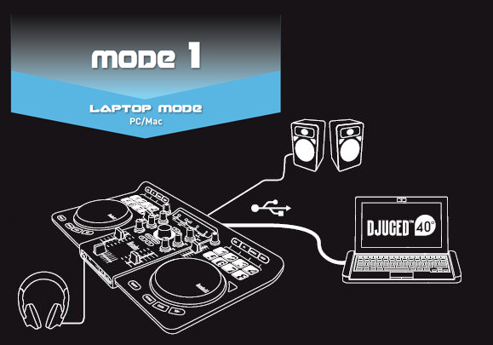
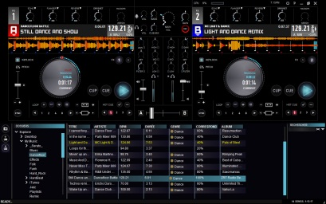

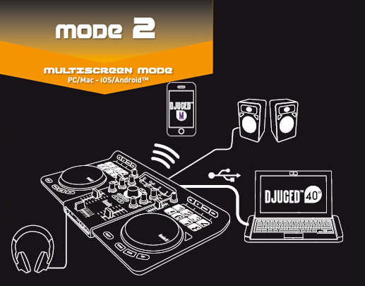
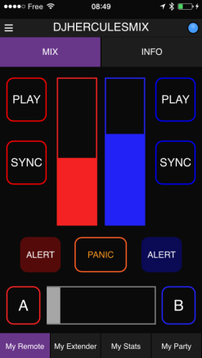
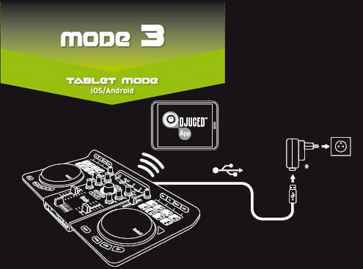
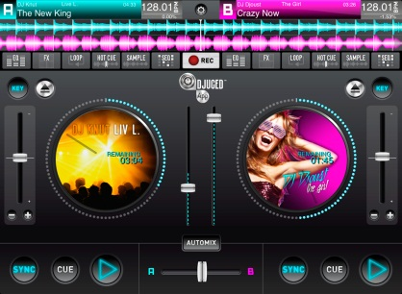
The DJ Party 3.0
www.hercules.com
DJUCED™ 40°
Comprehensive and intuitive DJing software
PC/Mac - Included in pack
DJUCED™ Master
Extend your DJ controller with the My Remote and My Extender modules. Invite your crowd to contribute to your party's success with DJUCED™ Party (playlist selection votes, track requests and special messages).
DJUCED™ Master is an evolutionary app, available for free from the iOS and Android stores
DJUCED™ App
All the DJing features you need at your fingertips
DJUCED™ App is a DJing application available from the iOS and Android stores
Note: please check your Android device compatibility here
Product reference / Barcode
EMEA: 4780773 / 3 36293 474451 9
USA : 4780773/ 6 63296 41968 2
© 2014 Guillemot Corporation S.A. All rights reserved. Hercules® is a registered trademark of Guillemot Corporation S.A. Apple and iPad are trademarks of Apple, Inc, registered in the United States of America and other countries. The Bluetooth® brand and logo are registered trademarks of Bluetooth SIG, Inc., and are used under license by Guillemot Corporation. Microsoft®, Windows® XP, Windows® Vista, Windows® 7, Windows® 8 are registered trademarks of Microsoft Corporation. All other trademarks and brand names are hereby acknowledged and are the property of their respective owners. Images and illustrations not binding. Contents, designs and specifications are liable to change without prior notice and may vary according to countries.
Your contact:
xxxxxxxxxxxxxxxxxxxxxxx

Slide 4
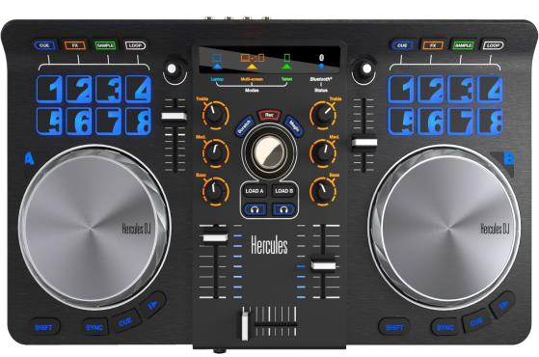
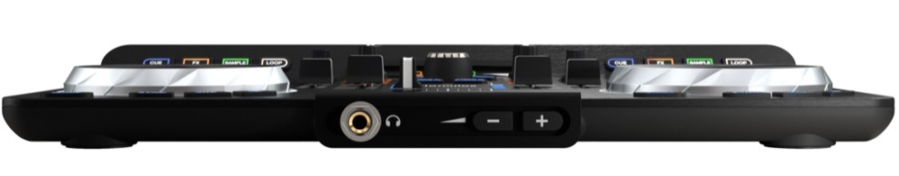
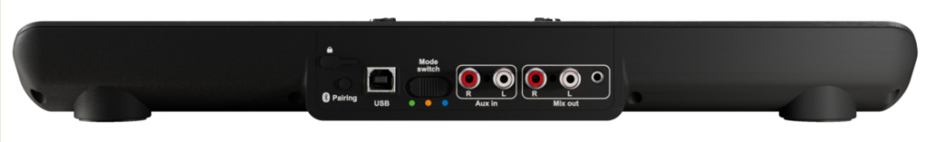

1 DJ controller. 3 modes
www.hercules.com
Mode display
Browse
encoder
Encoder
8 pads /
4 modes
A comprehensive DJ controller
Pitch fader
Capacitive
jog wheels
3-band EQ
Volume fader
Transport buttons
Play / Cue / Sync
Cross fader
Featuring a slim
and elegant design
With trendy
backlighting effects
Product reference no. / Barcode
EMEA: 4780773 / 3 36293 474451 9
USA : 4780773/ 6 63296 41968 2
© 2014 Guillemot Corporation S.A. All rights reserved. Hercules® is a registered trademark of Guillemot Corporation S.A. Apple and iPad are trademarks of Apple, Inc, registered in the United States of America and other countries. The Bluetooth® brand and logo are registered trademarks of Bluetooth SIG, Inc., and are used under license by Guillemot Corporation. Microsoft®, Windows® XP, Windows® Vista, Windows® 7, Windows® 8 are registered trademarks of Microsoft Corporation. All other trademarks and brand names are hereby acknowledged and are the property of their respective owners. Images and illustrations not binding. Contents, designs and specifications are liable to change without prior notice and may vary according to countries.

